Slide 1

iPLate Consultancy Project
Advised by Prof. Dr. Swarnalatha P

Slide 2
Problem Statement and Objectives
Assisting individuals to make `informed decision making`
Track the Human Body according to the Food Intake.
Tracking the Human Body according to the Activities.
Calculating the Calorie, Nutrients, Proteins and Carbohydrates based on Food Plate Image.
Extension of Plate to the Activities tracker using smart watch.

Slide 3
Milestones to achieve
Detect the Items and identify the ingredients present in the plate and map to calories, proteins and carbohydrates) as probabilities.
Considering the probabilities, combine it all into json version and get the text version from LLMs (using GenAI) reducing with less hallucinations.
1
3
2
Detect the weight of the plate (A Challenging task) we tend to use Computer Vision to calculate the volume of the plate/bowl in an image
4
Tracking the human body activities through changes and recommending the calorie content for the individual

Slide 4
Literature Survey (Most cited Papers)
Author | Approach | Results | Findings and Discussion
Parisa et al [1] | Segmentation based Size Estimation with identification of food in the images | 15 food items recognition with 90% accuracy. | Classical Programming Approach for nutrition info from the ingredients and suitable only for regular shaped foods.
Natta et al [2] | Mask RCNN based Segmentation which includes features for the YoloV5 based food detection and volume estimation through Bounding boxes | 9 Indian Food Items with 99% accuracy for food items identification. | Although food items can be detected by YoLo-V5 algorithm very effectively but the issue of weight remains the same.
Allegra et al [3] | An review of 434 papers have been made by the author which includes food intake monitoring and CV tasks. | Dataset with 1000 classes were found with a vast data. | It is found that some papers use heatmap for area and volume estimation and many use wearable sensors for detection (Bluetooth earphone with camera)
Nadeem et al [4] | Faster RNN approach is used for detecting the food items without segmentation and proposed an `Grab Cut` Algorithm for Volume Estimation | 80% accuracy with inclusion of fast food datasets. | Grab Cut Algorithm Works well but its doubted that it will work of real food such as dishes.

Slide 5
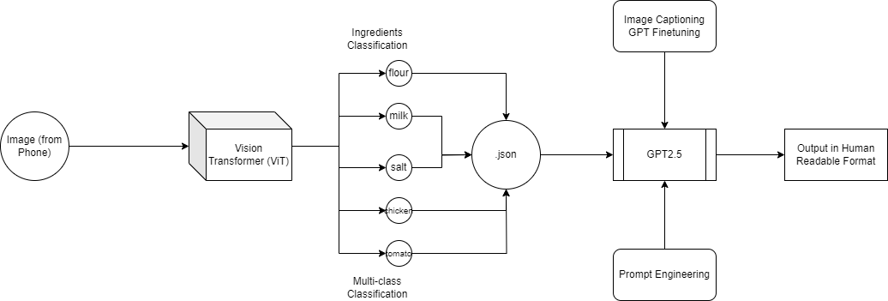
Proposed Algorithm (Milestone 1 - iter(1) )

Slide 6
Key Components and Technologies
Libraries and Frameworks: Utilizes Python with libraries such as streamlit for web app development, transformers and torch for machine learning, and nltk for natural language processing.
AI Models:
Image Captioning Model: A pre-trained Vision Encoder Decoder Model is used to extract ingredients from food images.
Text Generation Model: Models like GPT-2, GPT-Neo, or GPT-4 (via OpenAI API) generate nutritional advice based on the recognized ingredients.
Development Tools: Streamlit framework enables quick and easy web application development for AI projects

Slide 7
Implementation / Algorithm
1. Image Preprocessing
Input: User uploads a food image through the web interface.
Image Conversion: Convert images to RGB format to standardize input for the model.
Normalization: Use the Vision Transformer's (ViT) feature extractor to normalize the images, preparing them for efficient processing by the neural network.
2. Ingredient Recognition (Image Captioning)
Model: VisionEncoderDecoderModel (combining ViT and GPT-2).
Feature Extraction: The Vision Transformer (ViT) encodes the preprocessed image into a high-dimensional feature vector, capturing the visual information.
Caption Generation: The GPT-2 model decodes the feature vector to generate text captions, which are processed to extract ingredients.

Slide 8
Implementation / Algorithm
3. Ingredient Post-processing
Tokenization and Cleaning: Split the generated captions into individual ingredients, remove numerical values, and filter out non-ingredient text.
Stopword Removal: Exclude common English stopwords to focus on relevant ingredient names.
Duplication Removal: Eliminate duplicate ingredients to create a concise list.
4. Nutritional Analysis and Suggestions
Model: GPT-2, GPT-Neo, or GPT-4 (via OpenAI API for the web.py script).
Prompt Construction: Formulate a natural language prompt incorporating the identified ingredients, aimed at eliciting nutritional advice.
Text Generation: The language model generates a comprehensive analysis and suggestions based on the prompt.

Slide 9
Running Video

Slide 10
Why this method
ViT, a state-of-art 2023 image classification which uses Transformers as a concept which is shown to be the best classifier, provided given a huge data.
A lot of dishes with different varieties of cultural aspects should be taken into account, CNNs and their family like (ResNet, VGG16,..) are not suitable to classify various amount of ingredients present inside the image.
An inclusion of GenAI (LLMs) are used to have an interface between human and system and used by many Health companies as well (provided we should have less hallucinations).
(Hemanth - add point)

Slide 11
Deliverables
An ML model which expects to have a knowledge on overall cuisine structure .
An Less parameterized LLM for having the knowledge base of Calorie, Nutrients and Carbohydrates.
A Image input based weight and volume estimation of the food plate.
Health Tracker based on the Body Mass Index (according to the age).
More on Discussion.

Slide 12
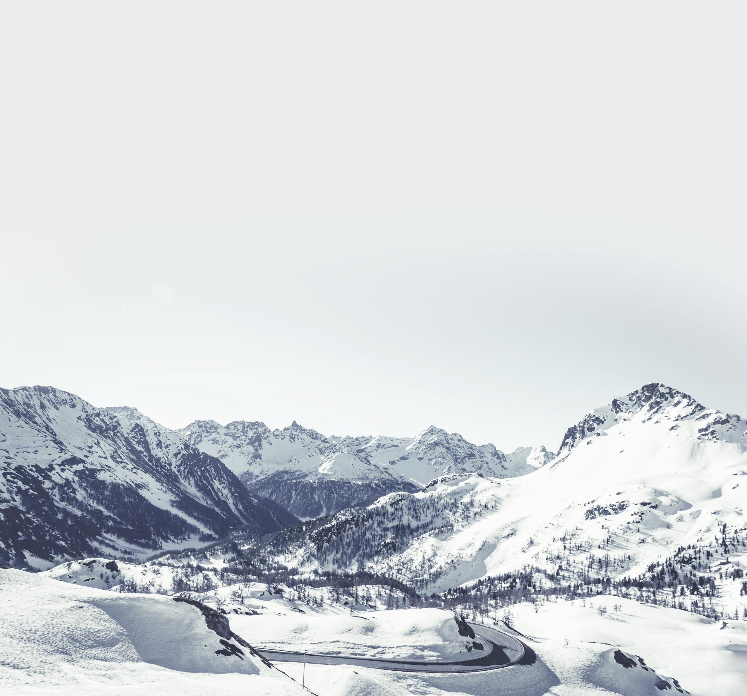
Timeline (Abstracted)
Augmenting the knowledge base of Calories, Nutrients Content of the Ingredients to LLMs for less hallucinations using RAG
Submission
DL Model (with Data Consideration) considering and selection of Target Audience
Trained Transformer model for Nutrients Classification for the particular Target Audience
Model Error Checking and Deployments
Feb 15
Mar 15
Feb 7
Mar 1
April 24

Slide 13
Team
This iPlate Consultancy Project is managed and advised my Prof. Swarnalatha P and currently we are a team of 3 with ML model developers like Sujay and IoT Engineers like Hemanth and Melvin with GenAI Developers.
SujayKumar Reddy M, 20BDS0294
Sales Director
Hemanth Karnati, 20BCT0280
Melvin Paulsam P, 20BCE0585

Slide 14
References
P. Pouladzadeh, S. Shirmohammadi and R. Al-Maghrabi, "Measuring Calorie and Nutrition From Food Image," in IEEE Transactions on Instrumentation and Measurement, vol. 63, no. 8, pp. 1947-1956, Aug. 2014, doi: 10.1109/TIM.2014.2303533.
Agarwal, Ritu, et al. "Hybrid Deep Learning Algorithm-Based Food Recognition and Calorie Estimation." Journal of Food Processing and Preservation 2023 (2023).
Allegra D, Battiato S, Ortis A, Urso S, Polosa R. A review on food recognition technology for health applications. Health Psychol Res. 2020 Dec 30;8(3):9297. doi: 10.4081/hpr.2020.9297. PMID: 33553793; PMCID: PMC7859960.
Nadeem, M.; Shen, H.; Choy, L.; Barakat, J.M.H. Smart Diet Diary: Real-Time Mobile Application for Food Recognition. Appl. Syst. Innov. 2023, 6, 53. https://doi.org/10.3390/asi6020053

Slide 15
Thank you.

